Slide 1

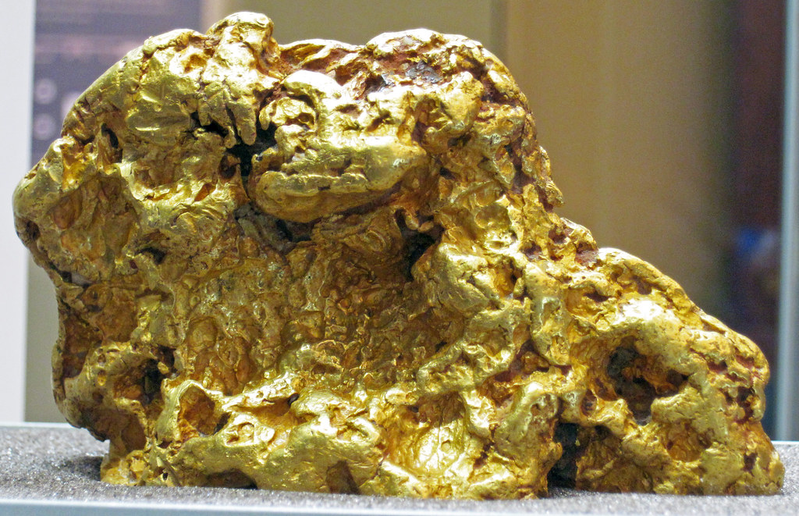
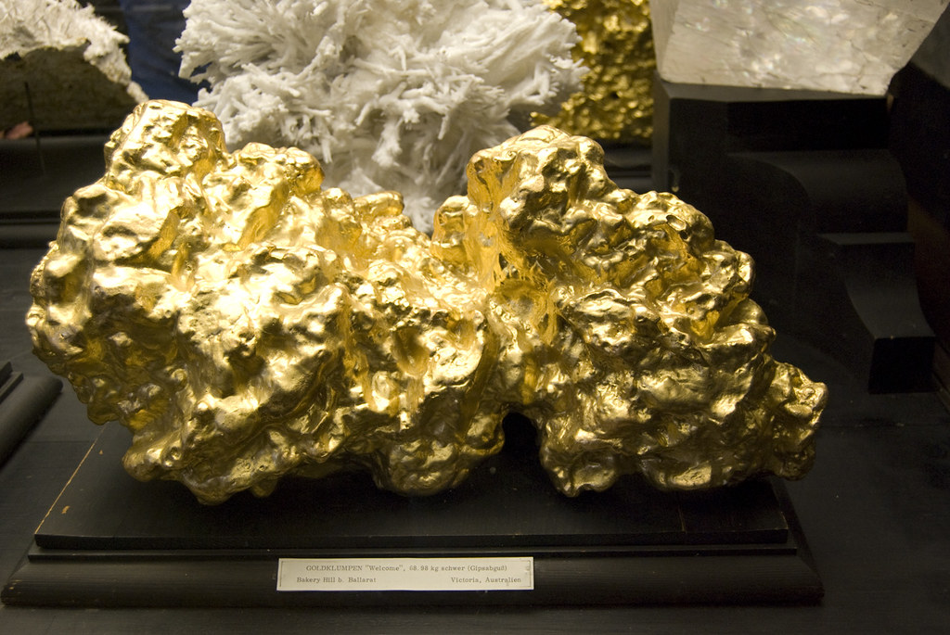
RED KING PROJECT
Leonora WA

Slide 2
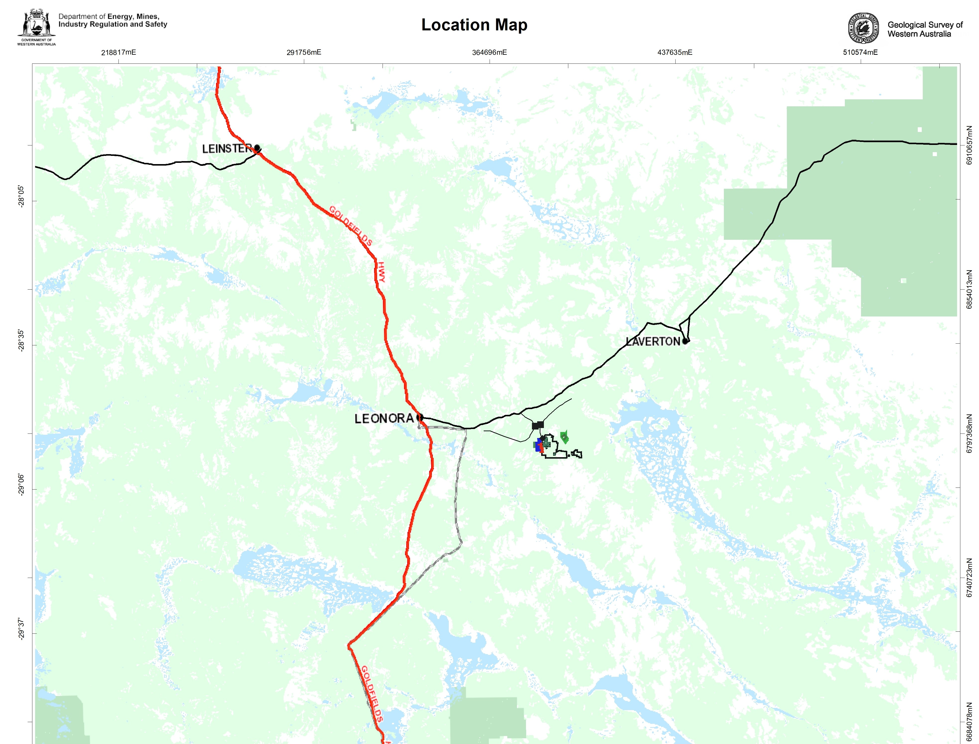
Red King Project
DRAFT
The Red King Project occurs in the Red Castle District between Leonora and Laverton south of the Leonora-Laverton Highway.
Access is via two gravel roads from the highway bypassing Minara Homestead and the historic Murrin Murrin tonwsite to the south towards Windsor Well.
Red King Project

Slide 3
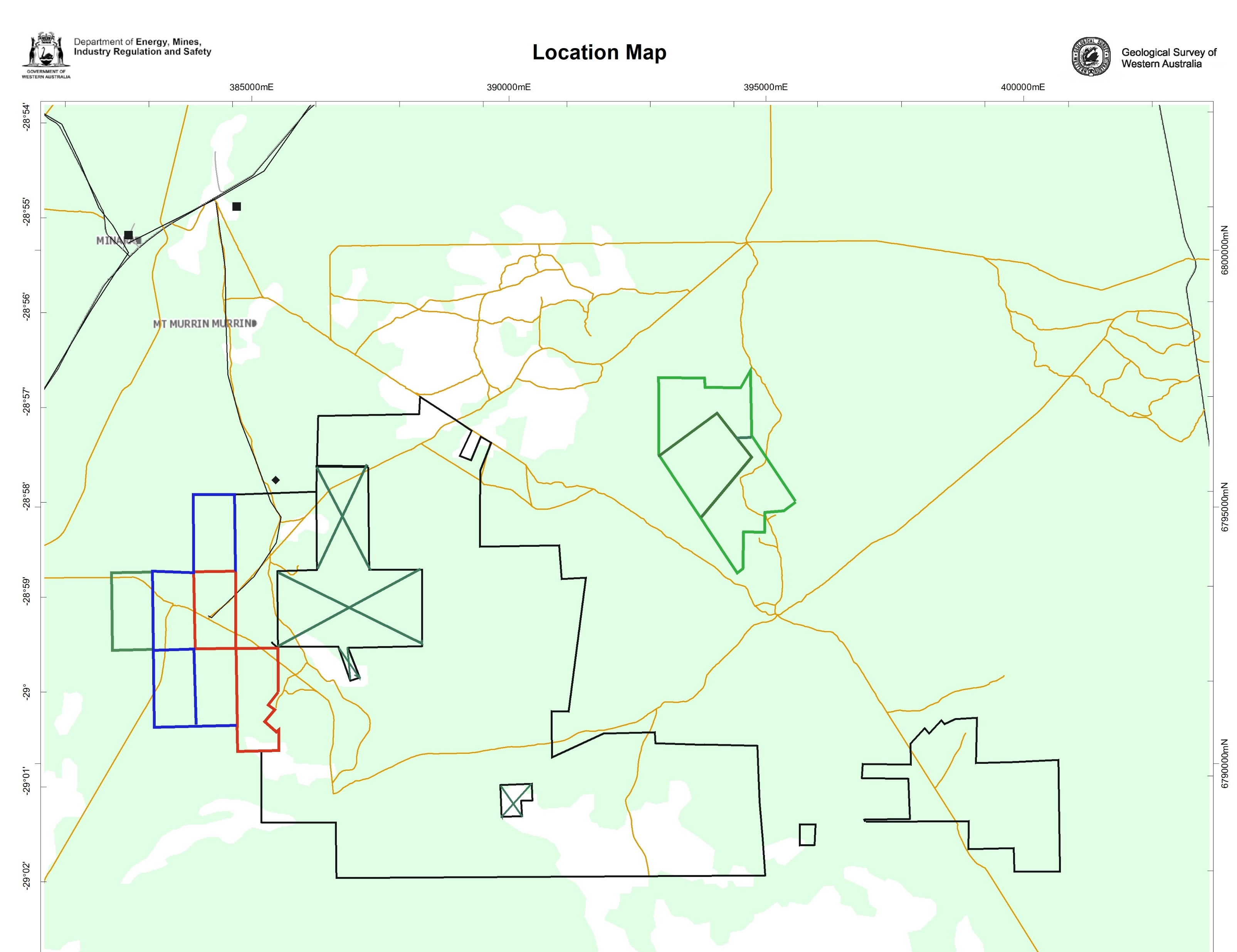
Red King Project
Red King Project includes M39/388 & P39/5467
Four surrounding PL’s are part of this Project under another name
Mining lease Application M39/1158 overlies P39/5467
The 6 tenements are associated with a surrounding group of 39 tenements known as the Red Castle Project.
Red King Project
Holders
Connor
Keene
Freeth
Chapman
Notes:
Mining Lease M39/388 and Prospecting Licence P39/5467 are located in the Redcastle District between Leonora and Laverton south of the Leonora – Laverton highway (Refer: Figure 1) and then accessed by two gravel roads, a southbound track bypassing Minara station and another south bound track passing the historic Murrin Murrin townsite towards Windsor Well. Both tenements held by prospector Brendon Connor who has previously held the four surrounding and former prospecting licences P39/5445 - P39/5448 which are now granted as prospecting licences P39/6310 – P39/6313. The six tenements including the mining lease and the five surrounding prospecting licences have been referred to as the Red King Project. A Mining Lease application M39/1158 overlies prospecting licence P39/5467 and the Red King tenements have been associated with a surrounding group of 38 tenements, referred to as the Red Castle Project.

Slide 4
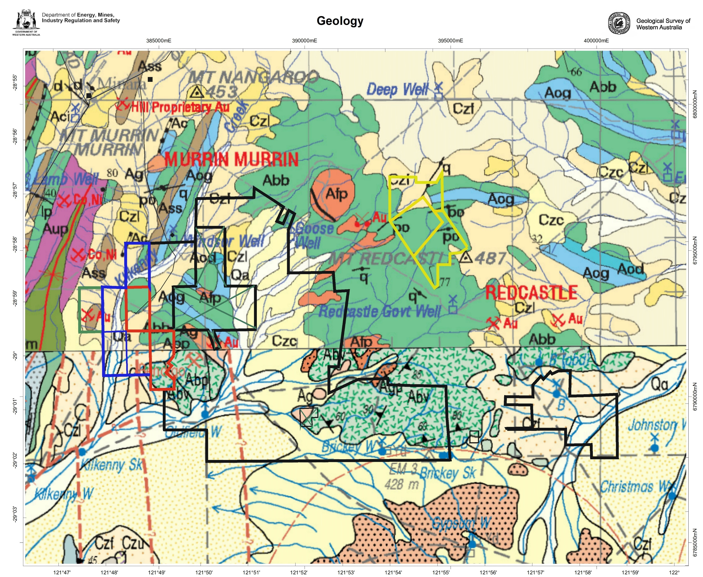
Red King Project
1:250,000
The Red King – Redcastle Projects lie within the Murrin-Margaret geological sector (after Hallberg 1985) bounded by the Keith-Kilkenny tectonic zone to the west and the Celia fault to the east.
The Red King geology includes a NE plunging synform and steeply dipping western limb which hosts a prominent shear.
L:ithology is dominated by tholeiitic and high Mg ocellar and spinifex textured basalts, ultramafics and interflow sediments.
Red King Project is SSW of Windsor Well which borders a larger tenement area known as the RedCastle Project.
The Red Castle area covers E-W trending sequence of theoleiitic mafic volcanics, dolerites and gabbros intruded by granite.
Major E-W trending faults host numerous quartz veins and the majority of gold mineralisatioin
Red Castle Project
Red King
Project
RedCastle Project
RedCastle Project
Notes:
The main historic workings associated with the Red King Project are the Bendigo Group of workings partly on M39/388 ( crossing the northern boundary) and just above the northern boundary of P39/5467 (Refer: Figure 2). The style of gold mineralisation has been described as occurring in quartz reefs and stringers on the contact between carbonated sediments and basalts with reconnaissance mapping indicating two styles of mineralisation:
Gold mineralisation stratabound within narrow, sheared interflow sediment beds.
Brittle fracture-controlled mineralisation along NE and ENE trending structures.

Slide 5
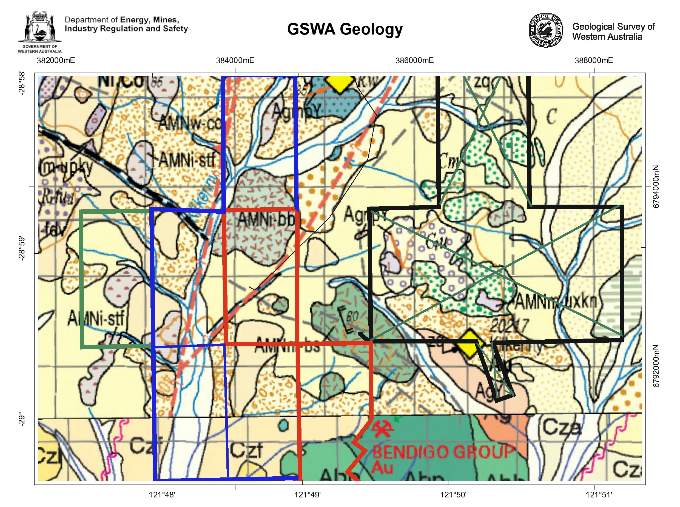
Red King Project
1:100,000
Interpreted major NNE curvilinear structure along the Kilkenny Creek juxtaposing NNE striking lithology to the west against WNW striking stratigraphy to the east (I’Ons 1989).
Examples of past production include: Bendigo Groups of Workings 274ozAu for 970tons – av 57.5g/tAu; Little Battery Group 940ozAu for 970tons – 30.1g/tAu.
Gold mainly occurs in narrow NE to NW trending pyritic quartz veins with gold workings proximal to granodiorite intrusives
Red King Project
Notes:
Near the eastern boundary of M39/388 on the main track, a north west line of shafts (Azimuth 320deg.) on a former GML 435T is present. Quartz fragments are prominent on the spoil heaps surrounding the shafts including doleritic rock and heavy quartz rubble. West of these shaft workings two deep shafts strike in a north-east direction (050-060deg.) on another former GML433T which indicates that there are two significant mineralised structural directions.

Slide 6
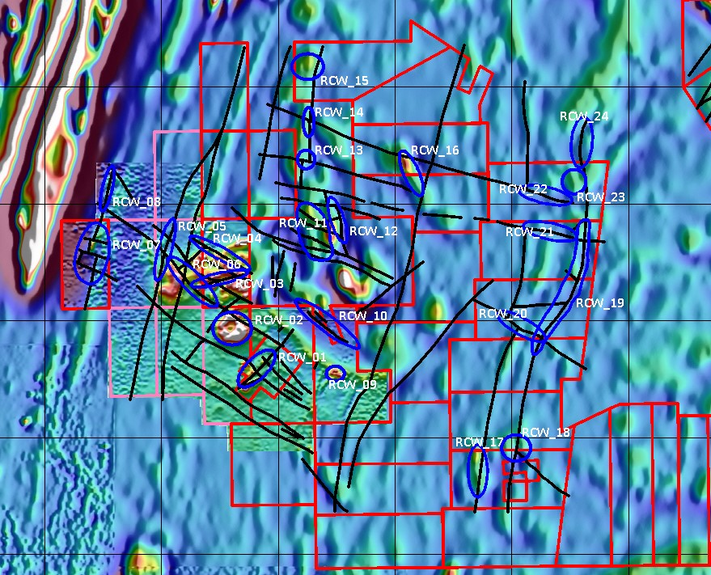
Red King Project
A ground magnetic survey was monitored by Southern Geoscience Consultants (SGC) generating several interpreted targets.
Total magnetic intensity field data (TMI) was gridded at a 10m cell size.
Interpretation was based on mappable units, interpreted contacts and structures from contours generated from the processed magnetic data set.
Priority targets were generated generally as the intersection of NW and NE trending structures.

Slide 7
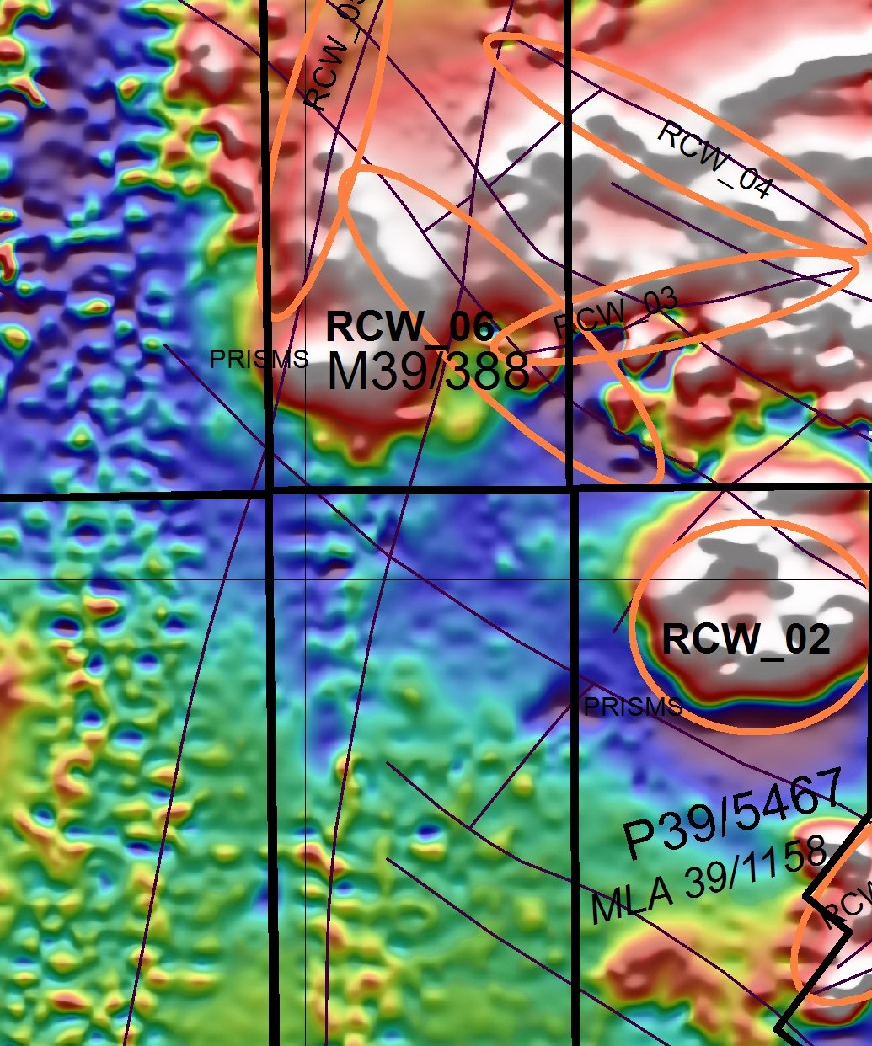
Red King Project
        .
Ten potential targets RCW01 – RCW10 were identified by SGC (Huzi 2016) based on structure and historic workings .
The SGC targets RCW02 and RCW06 were selected for further modelling work by Craven & Associates in 2020 at an optimal angle to the original ground magnetic data set.
The two targets areas formed the Red King Project with the Betty&Llyod Historic workings on M39/388 and historic alluvial workings on P39/5467.
Notes:
Modelling of the ground magnetic data by Southern Geoscience Consultants (SGC) from data received in the 2015-2016 survey has indicated the potential targets RCW01 – RCW06 (Refer: Figure 3) which have been backed up with work done by Bruce Craven & Associates in 2020. Craven used a magnetic data set at right angles (optimal angle) to the magnetic units which significantly smoothed the inherent noise in the original east–west ground magnetic line data. The target RCW02 on P39/5467 and RCW06 on M39/388 (Huizi2016) was selected for further modelling work

Slide 8
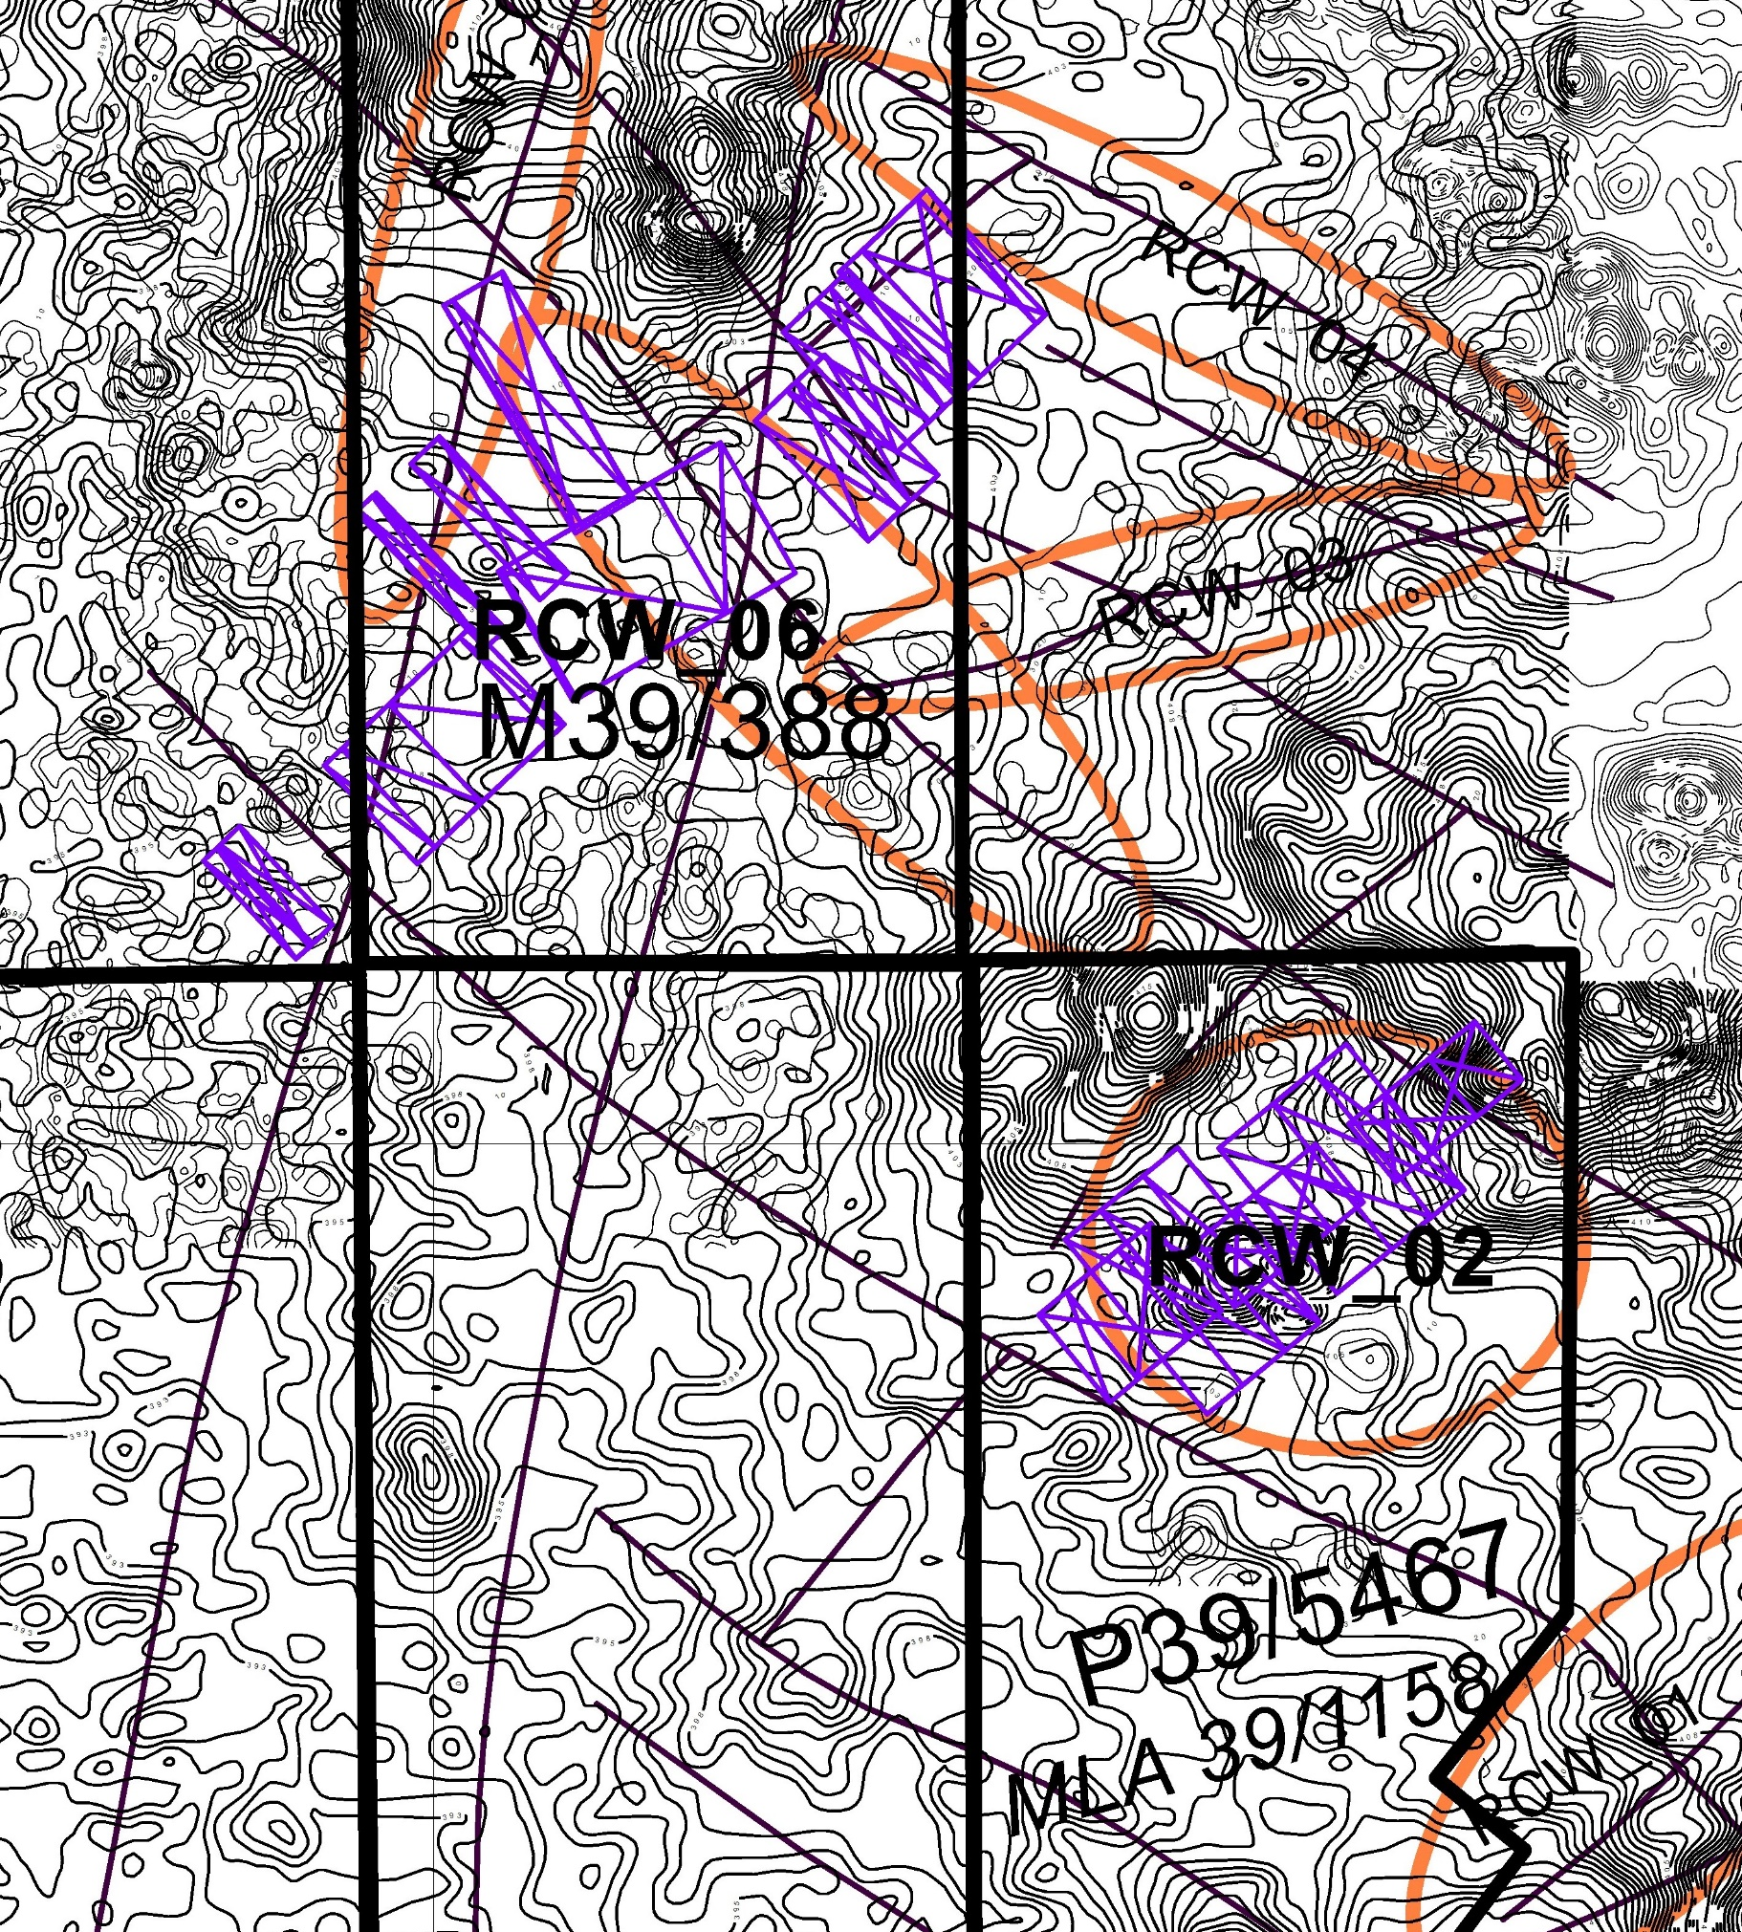
Ked King Project
SGC had indicated the NW direction of the lineaments as the main structural corridor with the intersection of N-NNE connecting structures hosting gold mineralisation.
Craven concluded that the variation in magnetism at both targets areas offered potential for gold mineralisation.
The steep SW dipping rectangular prisms were considered as potential targets.
Strong circular magnetic feature on P39/5467 hosts historic workings and quartz veining in a ENE direction.
Notes:
Craven used a magnetic data set at right angles (optimal angle) to the magnetic units which significantly smoothed the inherent noise in the original east–west ground magnetic line data. The target RCW02 on P39/5467 and RCW06 on M39/388 (Huizi2016) was selected for further modelling work by Craven and the conclusion drawn was that the variation in the magnetism offered potential for gold mineralisation. The work indicated a series of steeply south westerly dipping rectangular prisms as the potential targets (Refer: Figure 4). The strong circular magnetic feature on P39/5467 detected from the ground magnetic survey conducted in 2015 hosts historic pit workings and quartz veining, trending in an ENE direction, reflecting the anomalous soil geochemistry gold assay results with a peak result of 105ppbAu. Modelling of the ground magnetics by Southern Geoscience Consultants has indicated the NW direction of lineaments as the main structural corridor with the intersection of N-NNE connecting structures likely hosting the gold-quartz Mineralisation

Slide 9
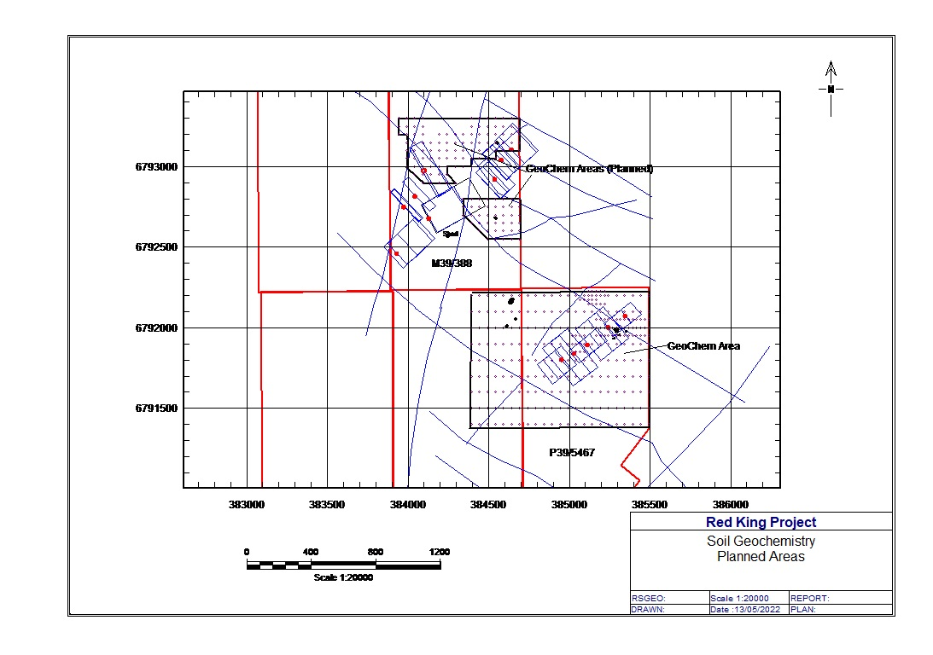
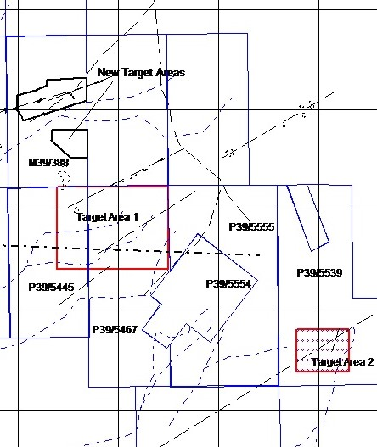
Red King Project
Auger soil sampling programmes were planned on the two geophysical targets RCW06 and RCW02.
The sampled areas incorporated successful metal detecting areas for gold and historic workings.
Two areas on M39/388 totaling approximately 26 Ha on 50x50m grid patterns.
Area covered on P39/5467 approximately 1.2sq kms on 100m x 50m grid pattern followed by infill sampling at 50 x 25m.
An auger soil programme on the Red Castle Project Licence P39/5539 covered an area of 1.5sq kms
Notes:
The auger soil geochemistry programmes on M39/388 and P39/5467 were carried over historic workings and where metal detecting had been successful. Site visits were made including discussions on where metal detecting had discovered significant quantities of fine gold nuggets generally weighing less than one gram. The area on M39/388 where the soil geochemistry was applied was in two areas totalling approximately 26Ha using 50m X 50m grid patterns. The area covered on P39/5467 involved an initial programme of 100m x 50m augured soil samples over a prospective area of approximately 1.2sq kms. This was followed by a programme infilling the anomalous area to a 50m X 25m pattern.

Slide 10
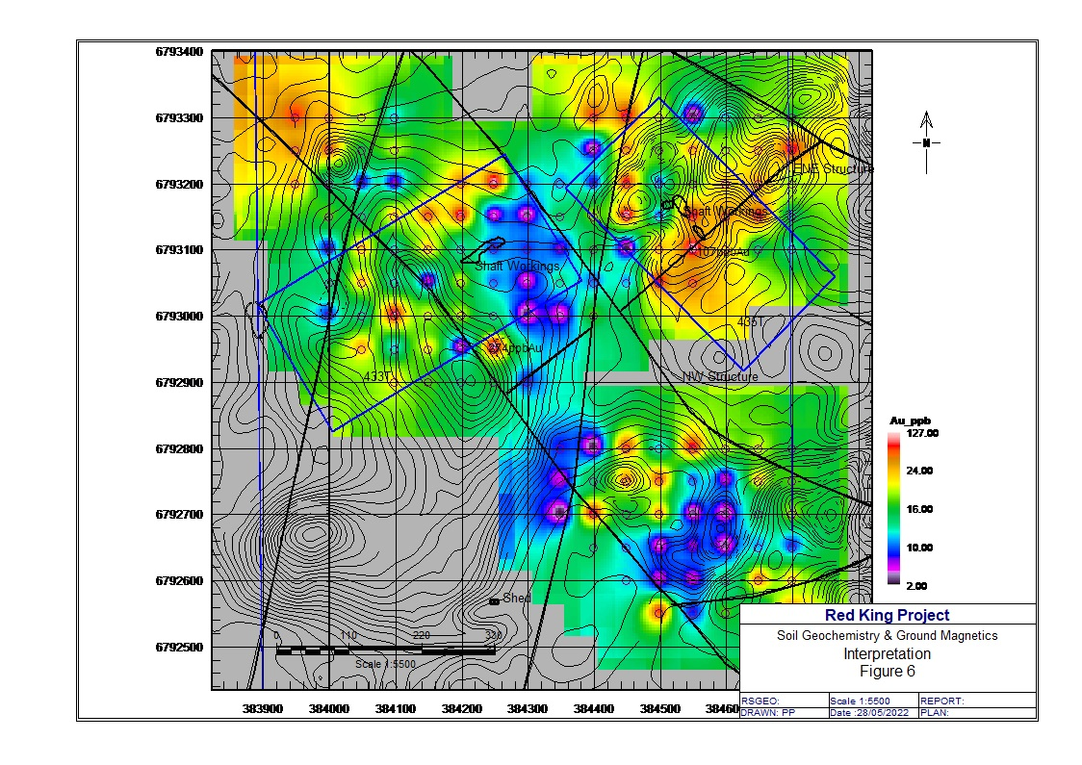
Red King Project
Northern Anomaly RCW06 included rectangular plates containing magnetic and non-magnetic features
Features considered partly or wholly zones of altered rock or gold mineralised structures.
Non magnetic zones could also reflect altered or mineralised structures.
Anomaly RCW06 interpreted as a ENE structure co-inciding with a peak auger soil value of 107ppbAu
Notes:
The Northern Anomaly RCW06 on M39/388 has included the rectangular prisms containing significant magnetic and non-magnetic features. The features are considered to be partly or wholly zones of altered rock or gold mineralised structures, constrained in plan and interpreted as targets for drilling particularly where elevated gold in soil anomalies have been located. The non-magnetic areas could reflect altered or mineralised zones within the defined plates, indicating that the peak soil geochemistry results within a plate should be considered a drilling target.
The ground magnetic contours of the northern anomaly (RCW_06) delineated a probable ENE structure associated with the elevated gold result in soil which included a peak value of 107ppbAu (Refer: Figure 5a ). Other elevated values of significance included 73ppbAu and 41ppbAu with background values nominally less than 20pbbAu.

Slide 11
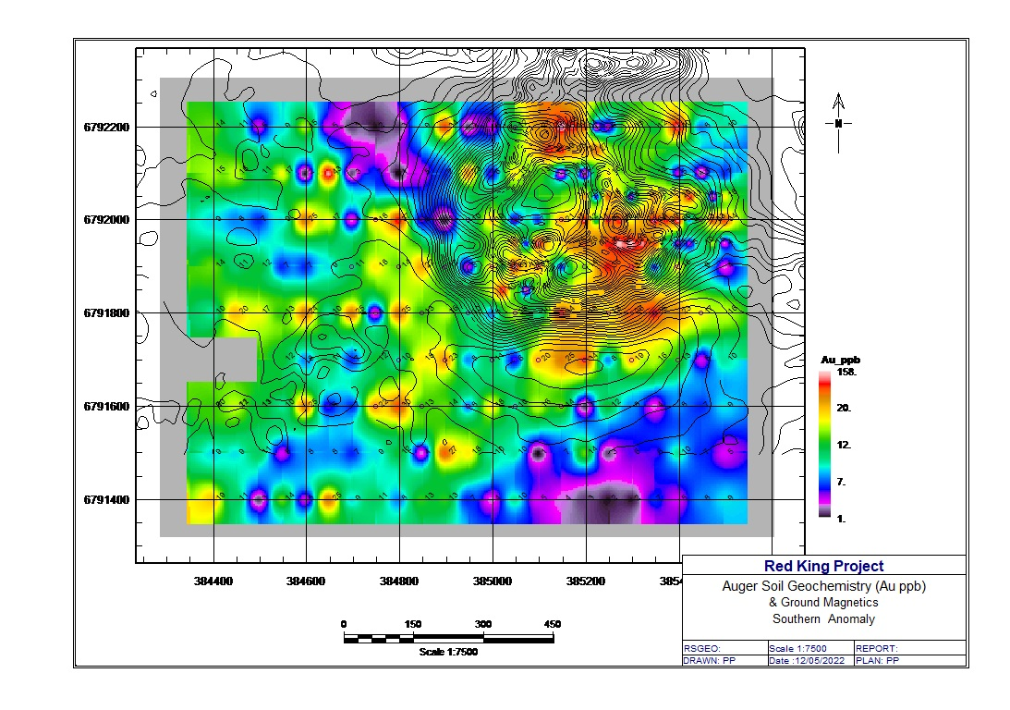
Red King Project
Ground magnetic contours identified significant disturbance within RCW02 on P39/5467.
Indicating complex structures with elevated gold assay values including a peak value of 158ppbAu.
Other elevated values included 80ppbAu, 64ppbAu with background less than 20ppbAu.
Within this anomaly Barium and Strontium appear to be associated with the anomalous values
Notes:
The ground magnetic contours identified significant disturbance within the isolated RCW02 anomaly on P39/5467 indicating complex structures associated with the elevated gold assay values in the subsequent soil geochemistry programme which included a peak value of 158ppbAu (Refer: Figure 5b). Other elevated values of significance included 105ppbAu, 85ppbAu, 80ppbAu, 64ppbAu with background values nominally less than 20ppbAu. Within the southern anomaly elements Barium and Strontium appear to be associated with the anomalous gold mineralisation. and elements Titanium and Vanadium appear to follow a NNE trend

Slide 12
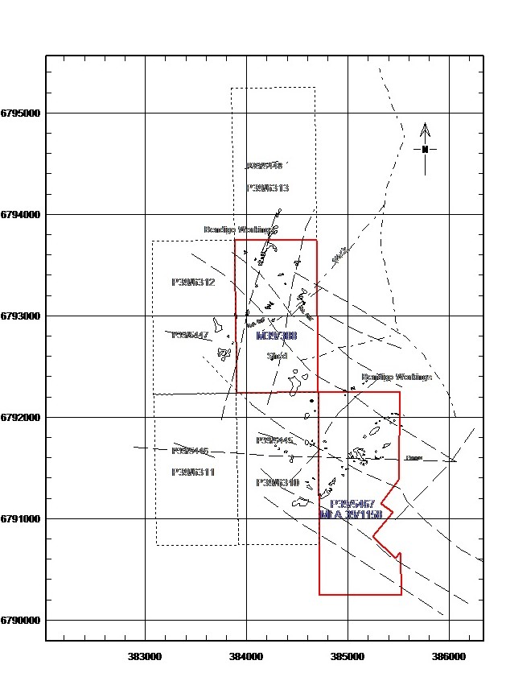
Red King Project
Successful metal detecting has occurred have been on M39/388 and P39/5467. Large area pushed and rehabilitated on P39/5467.
Historic Bendigo workings Group A crossing the northern boundary of M39/388 following a north trending chert horizon.
Bendigo workings Group B adjacent to the northern boundary of P39/5467 and probably associated with the soil anomaly of 158ppbAu on this PL.
Recent discovery of alluvial gold trend along old creek in southern area of P39/5467
Notes:
Metal detecting has been successful from the evidence of several worked areas on M39/388 and P39/5467. Historic workings include shallow shafts, pits on quartz veining trending north west and north-east directions. Part of the Bendigo group of workings crossing the northern boundary of M39/388 are associated with an interpreted north trending structure and chert horizon (Refer: Figure 2). Metal detecting on P39/5467 and surrounding areas with a front-end loader has always proved successful with ground evidence including rehabilitation and windrows of pushed soil. Historic workings including shallow shafts and pits on quartz veining trending in a ENE direction are present which includes another Bendigo group of workings adjoining the northern boundary of P39/5467 with the likely association of the gold soil anomaly on P39/5467 which shows a peak result of 158ppbAu.

Slide 13
Red King Projec t
A limited RC drill programme was used to assess the orientation of the mineralisation below peak soil assays of 105ppbAu and 85ppbAu.
Gold assay results indicated low grades at an average depth of 25 - 30 metres.
Results included:
RKRC01 – Im@0.42g/tAu from 34m
RKRC02 – 2m@0.6g/tAu from 28m
- 3m@0.7g/tAu from 36m
- 3m@0.53g/tAu from 30m
RKRC03 – 2m@0.56g/tAu from 29m
- 3m@0.2g/tAu from 38m
RKRC 06 – 5m@0.5g/tAu from 38m
Quartz veining varied in intensity however quartz reef style intervals of >95% quartz was intersected in RKRC02, 03 and 06 indicating significant dilation and probable higher grade gold mineralised structures at depth.
Notes:
RC drilling was carried out in April 2022 with four metre composite samples being submitted for analysis. Upon receipt of results one metre composite samples of the anomalous four metre samples were submitted for analysis. Gold assay results included lower grade economic mineralisation to an average depth of 27m as follows:
RK01 – 1m @ 0.42g/t from 34m
RK02 – 2m @ 0.60g/t from 28m
3m @ 0.70g/t from 36m
3m @ 0.53g/t from 30m
RK03 - 2m @ 0.56g/t from 29m
3m @ 0.2 g/t from 38m
RK06 - 5m @ 0.5 g/t from 38m
Limited drilling was used to assess the orientation of the mineralisation below peak soil assays of 105ppb and 85ppb (Refer: Figure 5b). RKRC01, 05 were drilled with a NNW azimuth of 330deg.; RKRC02, 03 and 04 in an ENE direction of 60deg. and RKRC06 was a vertical hole designed to intersect mineralisation associated with significant (> 95%) quartz or quartz reef mineralisation. The drilling programme totalled 316 metres covering an area of approximately 200sqm in a potentially mineralised and magnetically disturbed area of 18Ha (Refer: Figure 6). The close spaced holes appear to have indicated the occurrence of mineralisation at a vertical depth of 23 -33 metres and such mineralisation occurs from the surface to a maximum depth of 33 metres associated with quartz veining in weathered rock. The quartz veining was varied in intensity however quartz reef style intervals of 95%-100% quartz was intersected in drill holes RKRC02, 03 and RKRC06 indicating the presence of strong dilation and probable shearing and mineralisation (Refer: Figure 7). It is apparent that leaching of gold mineralisation has occurred in the weathered zone and therefore lower patchy grades are present. It is anticipated that the grades will be stronger at depth with the presence of higher grade shoots, which is generally a common scenario for gold deposits in the Goldfields region. Lower economic gold grades in drilling and strong soil geochemistry within a circular magnetic feature has indicated the presence of mineralised structures which is sufficient evidence for a continued alluvial mining operation.

Slide 14
Red King Project
One hole was drilled on M39/388 in NNE direction adjacent to a soil anomaly of 107ppbAu.
Hole collared approximately 50m SW of the NW line of workings on GML435T
4m @0.4g/tAu from surface with the individual 1m assays averaging 3m@0.38g/tAu and 0.23g/tAu from 6-7m down hole were the anomalous results received.
It is anticipated that gold grades at depth will be stronger on both M39/388 and P39/5467 as leaching of gold mineralisation is apparent in the weathered zone.
Notes:
Only one RC hole RKRC007 has been drilled on M39/388 in a north east direction; collared adjacent to where the soil geochemistry indicated a gold anomaly of 107ppbAu. This augured soil location was approximately 50 metres south west of the north west trending line of workings on former GML 435T which includes a deep historic shaft at the northern end (Refer: Figure 8). The drilling programme was not completed due to the drill rig having to leave early and therefore only one shallow (46m) hole was drilled based on the peak soil anomaly and a NW trending line of workings. The results were encouraging in the 1st four metres of the hole including:
4 metres @ 0.4g/tAu from the surface with the individual one metre assays averaging 3 metres @ 0.38g/tAu from the surface as well as 0.23g/tAu from 6m – 7m downhole.
From the results further drilling is warranted as these elevated near surface results which generally indicate deeper mineralisation.

